Slide 1
If you are a CEO of a software Company, give suggestion about your recruitment. What are the things you will expect from the candidate?

Slide 2


Resume

Slide 3

Importance of a Resume

Slide 4
Introduction
A resume is a concise and strategic document that highlights your education, work experience, skills, and achievements to showcase your value to potential employers.
Effective resume writing is crucial in today's competitive job market, as it:
Grabs attention
A well-crafted resume stands out from the crowd, increasing the chances of getting noticed by hiring managers and recruiters.
Communicates your value
A resume clearly articulates your strengths, accomplishments, and relevance to the job, demonstrating how you can contribute to the organization.
Opens doors
A strong resume can lead to interviews, networking opportunities, and ultimately, job offers.
Enhances professional branding
A resume serves as a representation of your professional identity, showcasing your expertise and career progression.

Slide 5
To write a effective resume, focus on:
Tailoring your resume to each job application
Using clear and concise language
Highlighting achievements and impact rather than just listing responsibilities
Focus on
Focus on
Focus on
Incorporating relevant keywords from the job description
Formatting and structuring your resume for easy readability
Proofreading and editing to ensure error-free content
Focus on
Focus on
Focus on
Remember, your resume is often the first impression you make on potential employers, so invest time and effort in crafting a high-quality resume that showcases your skills, experience, and achievements.

Slide 6
Purpose of a Resume
To get an interview
To provide a summary
To open doors
To showcase achievements
To communicate value
To enhance professional branding
To demonstrate relevance
To differentiate yourself
To showcase transferable skills
Notes:
To get an interview: A resume's primary goal is to secure an interview with the hiring manager.
To showcase achievements: Highlight accomplishments, successes, and impact in previous roles.
To demonstrate relevance: Align skills, experience, and education with the job requirements and industry.
To differentiate yourself: Stand out from other applicants by showcasing unique strengths and qualifications.
To communicate value: Clearly articulate how skills, experience, and achievements can benefit the employer.
To provide a summary: Offer a concise overview of professional brand, highlighting expertise and career progression.
To open doors: A well-crafted resume can lead to new career opportunities, networking connections, and professional growth.
8. To enhance professional branding: A resume serves as a representation of professional identity, showcasing expertise and career progression.
9. To showcase transferable skills: Highlight skills that can be applied to various roles and industries.
10. To demonstrate career progression: Showcase career growth, promotions, and increased responsibilities

Slide 7
Resume - The footprint of a person's career achievements

Slide 8
The footprint of a person's career achievements
A resume leaves a lasting impression on potential employers, showcasing a person's accomplishments and experiences
It highlights a person's career progression, achievements, and impact over time
Leaves a mark
Captures progress
Represents their Brand
Provides evidence
A resume represents a person's professional brand, showcasing their unique strengths, skills, and experiences
It serves as evidence of a person's capabilities, demonstrating their value and potential to future employers
Notes:
A resume is often referred to as a "footprint" of a person's career achievements because it:
Leaves a mark: A resume leaves a lasting impression on potential employers, showcasing a person's accomplishments and experiences.
Captures progress: It highlights a person's career progression, achievements, and impact over time.
Tells a story: A resume tells the story of a person's professional journey, showcasing their skills, experience, and accomplishments.
Provides evidence: It serves as evidence of a person's capabilities, demonstrating their value and potential to future employers.
Represents their brand: A resume represents a person's professional brand, showcasing their unique strengths, skills, and experiences.
Just like footprints leave a trace of where someone has been, a resume leaves a trace of a person's career achievements and experiences, providing a snapshot of their professional journey.

Slide 9
How does a resume look like?

Slide 10








Components of a Resume
Contact Information
Work Experience
Resume Objective/Summary
Education
Skills
Certifications
Achievements
References

Slide 11

Contact Information
Full name, phone number, email address, location
LinkedIn profile (if applicable)

Slide 12

Work Experience
Listing previous jobs in reverse chronological order
Including job title, company name, dates, and bullet points describing responsibilities and accomplishments.
Elaborate your roles and responsibilities of your previous company

Slide 13
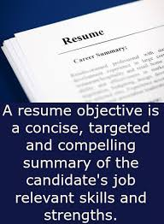
Resume Objective/Summary
Brief statement highlighting career goals and key qualifications, the post you are applying for.
“Objective: To find a career that will allocate dexterity from preceding experiences to perform a job to superiority. In addendum to facile and ardent task force will alleviate the work environment of unethical work habits.”
“Objective: To circumvent corporate America and reach free thinkers who don’t take themselves too seriously, but take monetary gain and peace of mind paramount a non-conformance with credit ability.”
“Objective: Hard-working, goal-oriented, and a team player seeking an opportunity to incorporate my skills and put them to use.

Slide 14

Education
Mentioning degrees, institutions, dates, and relevant coursework

Slide 15

Skills
Technical, soft, and transferable skills relevant to the job
Use bullet points for clarity

Slide 16

Certifications
Relevant certifications, licenses, and training
Tailoring Your Resume
Customizing the resume for each job application
Highlighting skills and experiences that match the job description

Slide 17

Achievements
Quantifiable accomplishments that demonstrate impact
Increased sales by X%, streamlined processes, etc.

Slide 18

References
Include contact details of the person who are working in the company you are applying for

Slide 19
Keywords and ATS
Importance of using keywords from the job description
Applicant Tracking Systems (ATS) and their role in resume screening
Length of the Resume
Generally 1-2 pages, depending on experience
Concise and relevant information

Slide 20
Resume Format

Slide 22
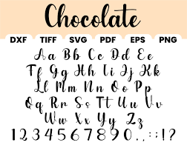




Design and Format
Font
Arial, Helvetica, Calibri, Garamond, Times New Roman, Georgia, Cambria, Verdana,Trebuchet MS
Font size
Body text of your resume is 11 or 12 points
Headings and subheadings - NOT bigger than 14 points
Font color
plain black,
headings, subheadings, or header - dark gray, navy, or forest green
Spacing
1.5-point spacing
Bullet points
same size of text
Avoiding excessive colors and graphics

Slide 23
Resume Models - Chronological
Listing work experience in reverse chronological order
Suitable for candidates with a clear career progression
Resume Models - Functional
Focusing on skills and qualifications rather than chronological work history
Ideal for those with employment gaps or changing careers
Resume Models - Combination
Combining elements of chronological and functional formats
Showcasing skills and achievements while also highlighting work history

Slide 24
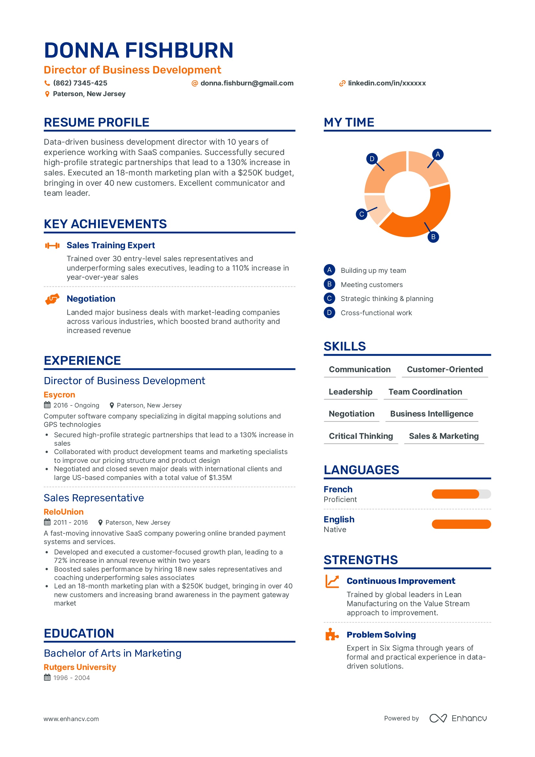
Creative Resumes
Infographic-style resumes or portfolios
Appropriate for creative fields
Online Resumes and Portfolios
Importance of having an online presence
Building a personal website or using platforms like LinkedIn

Slide 25
Resume Mistakes to Avoid
Spelling and grammar errors
Irrelevant information
Overly lengthy descriptions
Proofreading and Editing
Thoroughly reviewing the resume for errors
Seeking feedback from peers or professionals

Slide 26
Networking and Referrals
Leveraging personal and professional networks
Getting referred to job opportunities
Resume as a Marketing Tool
Positioning yourself as a solution to an employer's needs
Showcasing unique value and differentiators

Slide 27

Adapting for Different Audiences
Customizing resumes for different industries or roles
Highlighting relevant experiences and skills
Cover Letters
Writing an effective cover letter to accompany the resume
Tailoring the cover letter to the specific job

Slide 28
QUESTION 1
What should be included in the contact information section of a resume?
Social Security Number
Full name, phone number, and email address
Birthdate
Marital status
Notes:
ANS:B

Slide 29
QUESTION 2
How should work experience be listed on a resume?
In chronological order starting with the oldest job
In random order
In reverse chronological order starting with the most recent job
In alphabetical order
Notes:
ANS:C

Slide 30
QUESTION 3
What does tailoring your resume mean?
Printing it on colored paper
Customizing it for each job application
Adding personal photos
Using fancy fonts
Notes:
ANS:B

Slide 31
QUESTION 4
Why should you keep your resume concise?
To make it look short
To ensure it is easily readable and relevant
To use less paper
To fit it on one page
Notes:
ANS: B

Slide 32
QUESTION 5
How many main types of resumes are there?
8
6
7
3
Notes:
ANS: 3

Slide 33
Thank You
AND
Record your Feedback

